Slide 1
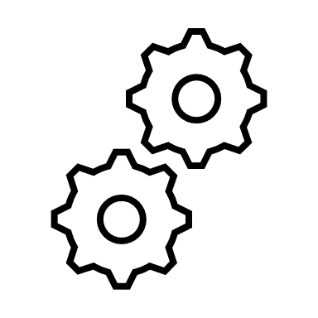
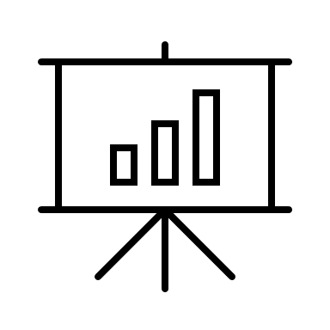



PSL PC DIGITAL

Slide 2

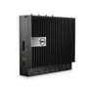





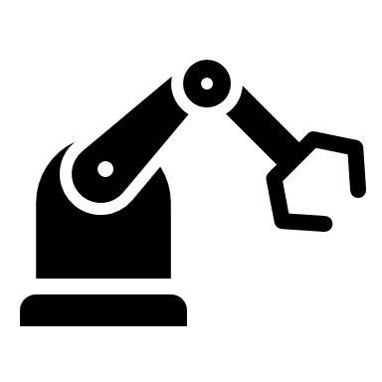
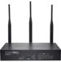

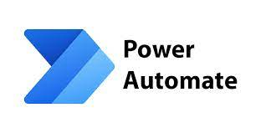
SAFETY FIRST!
End User
Azure Cloud
DMZ
Factory
Factory Firewall
Power BI
Unilever Azure
Local Data Sources
Standard Digital Factory Architecture

Slide 3
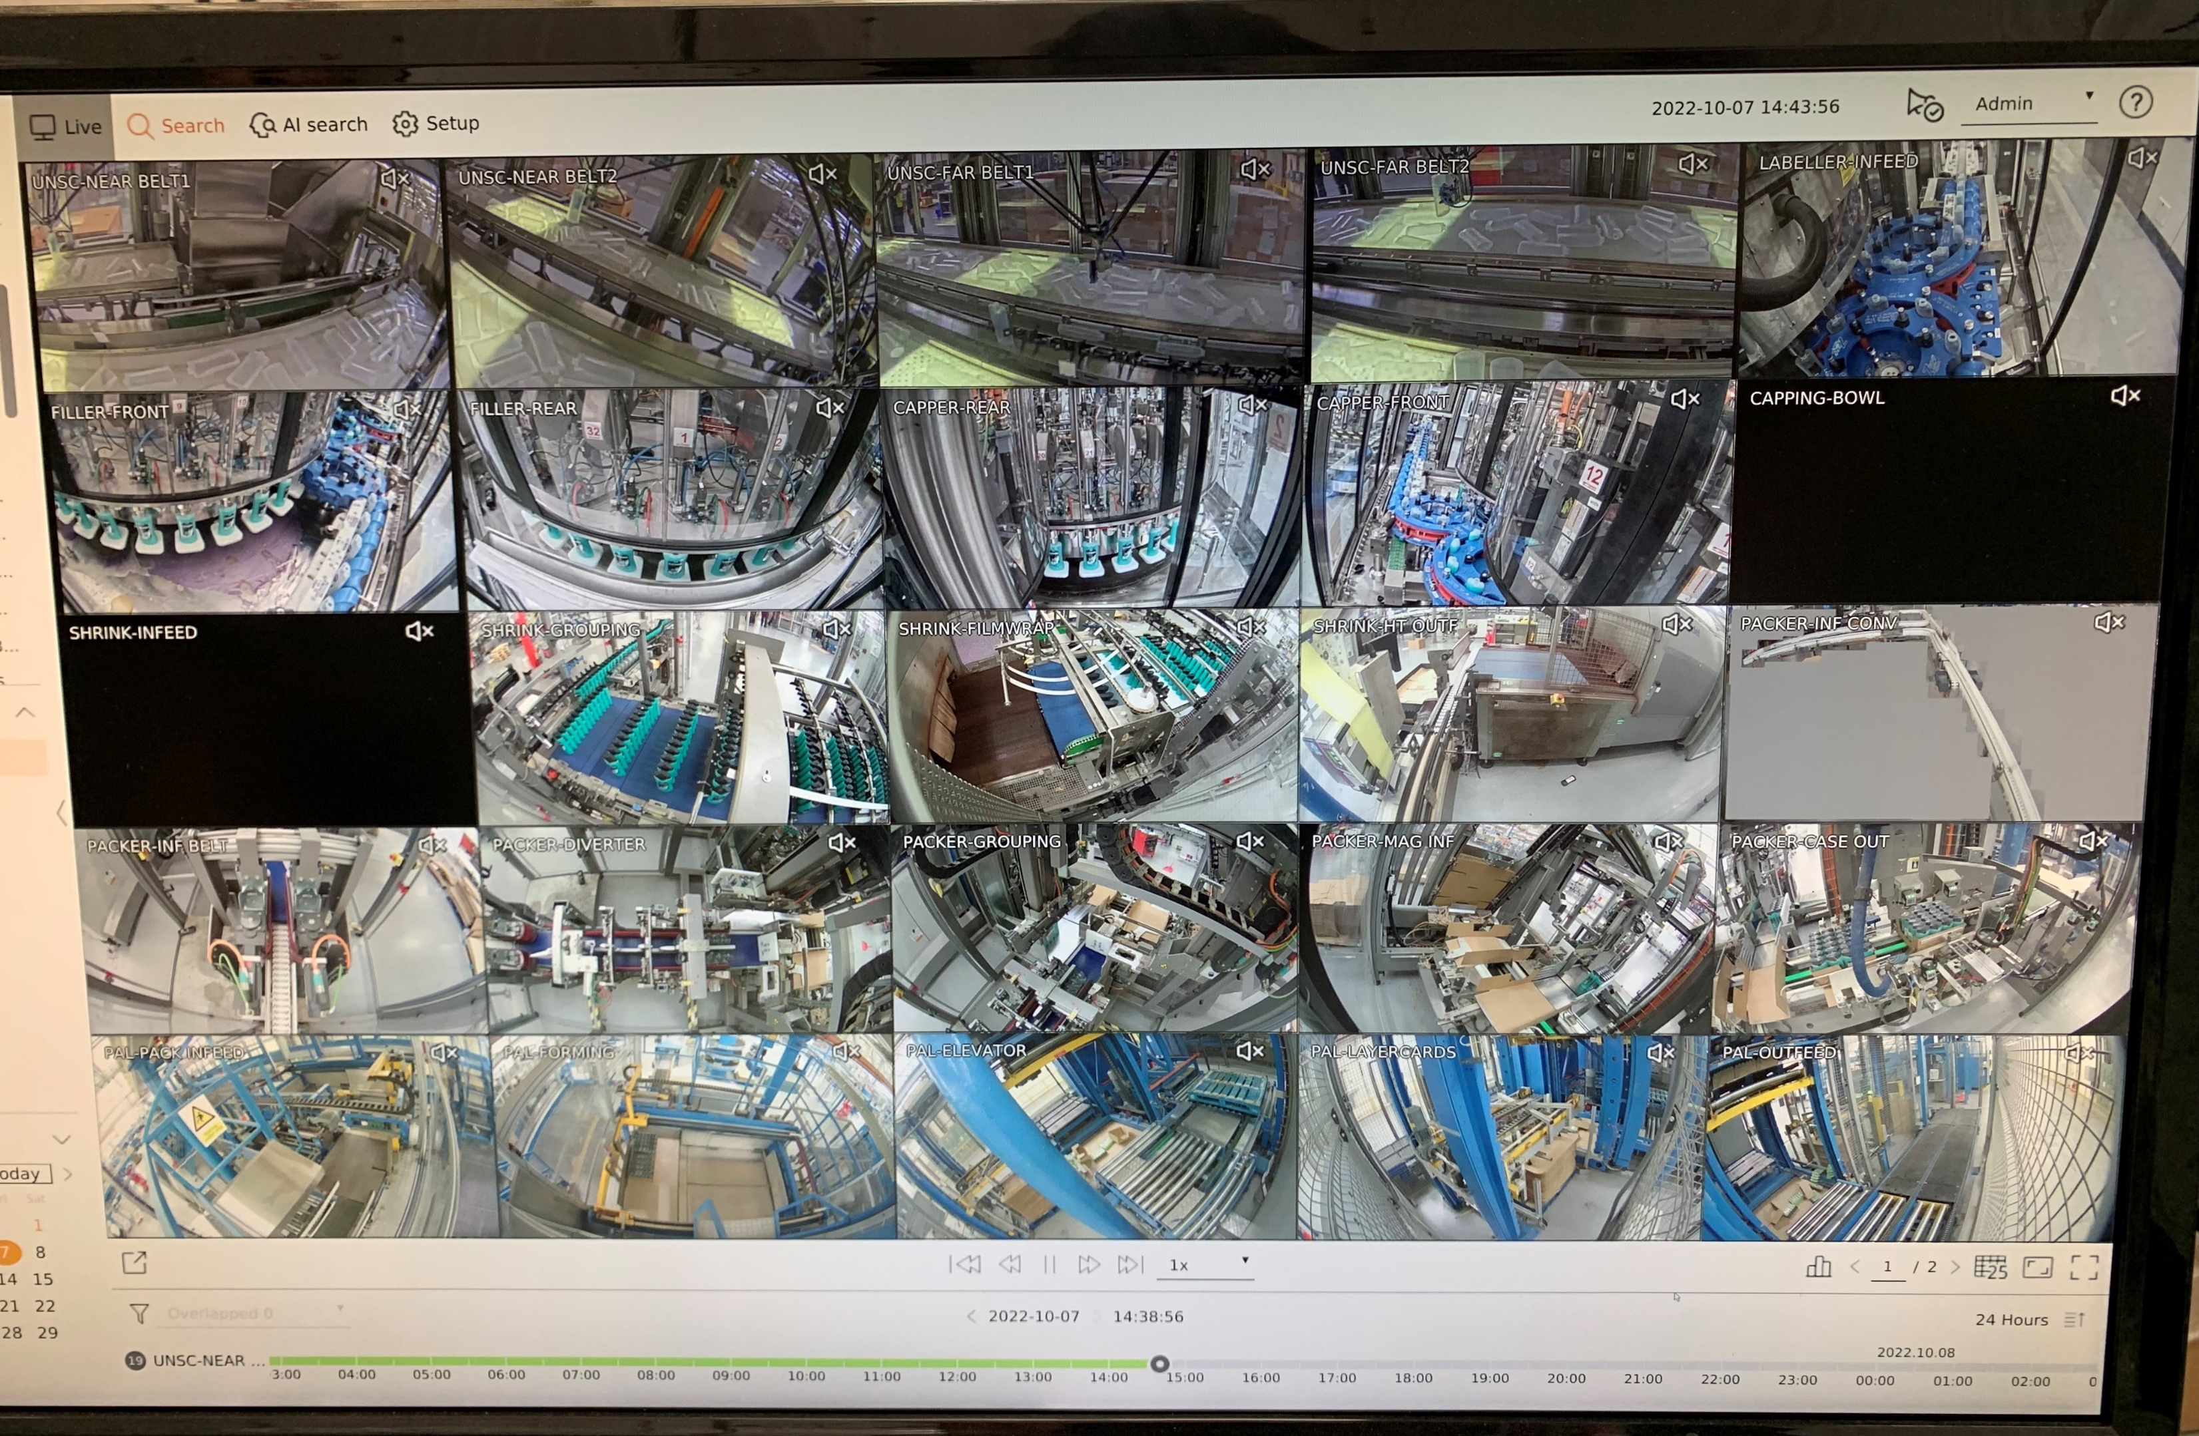

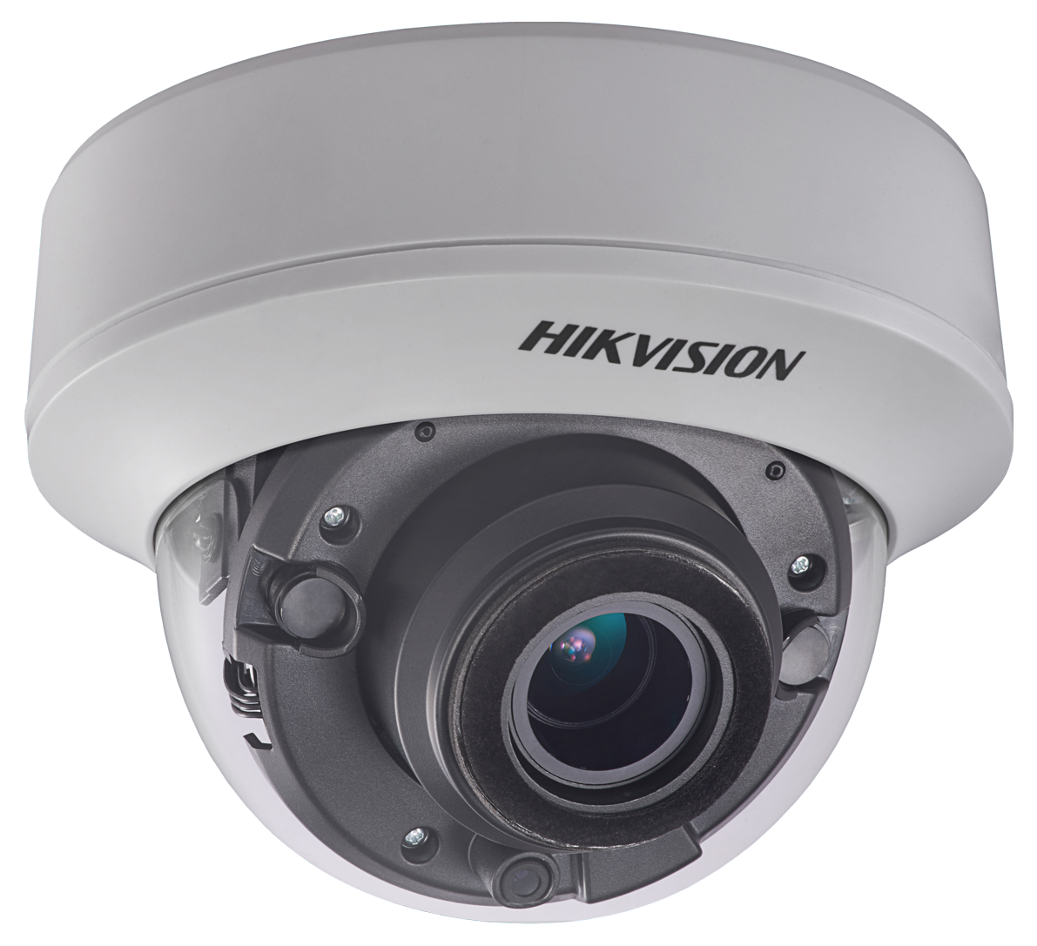
VISION SYSTEM

Slide 4

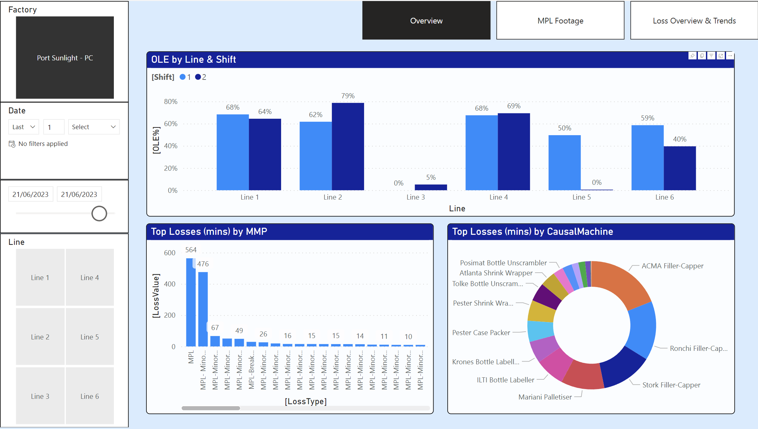
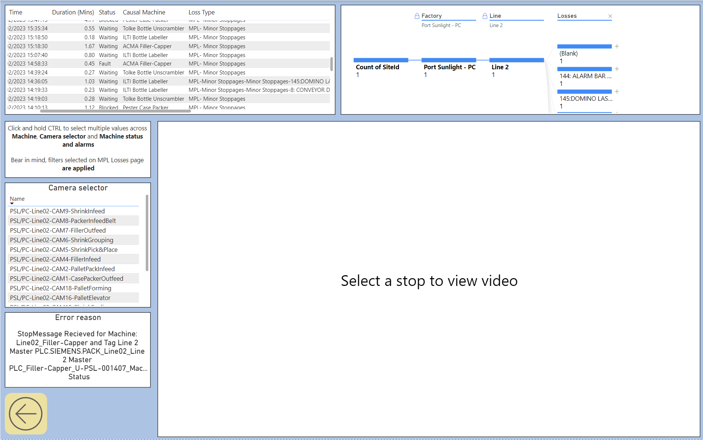
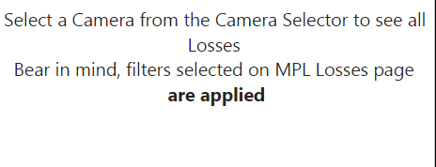
VISION SYSTEM

Slide 5
VISION SYSTEM

Slide 6
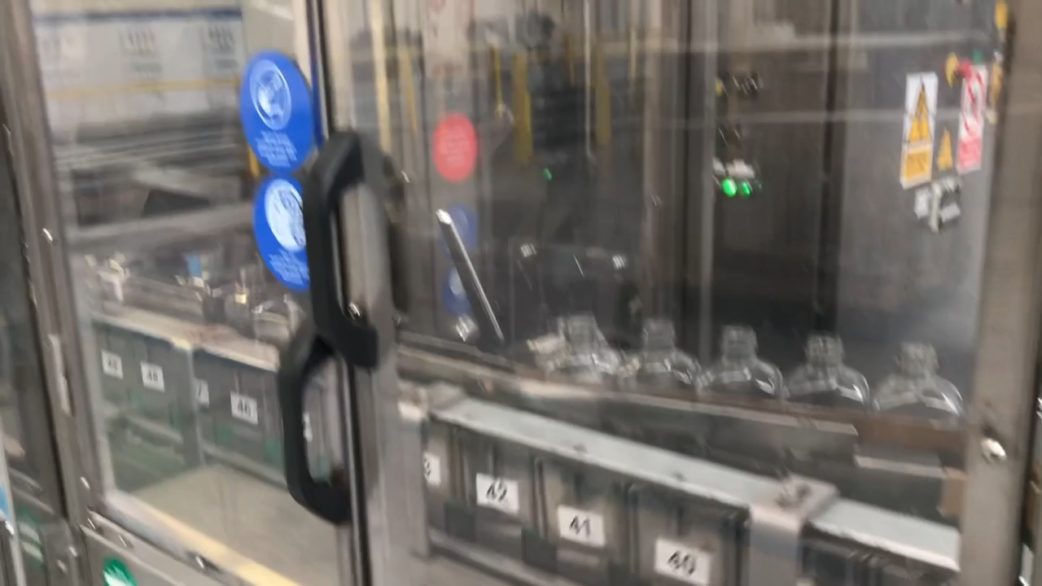
VISION SYSTEM

Slide 7
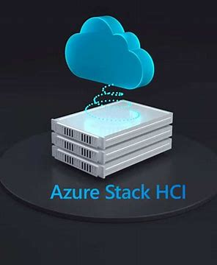
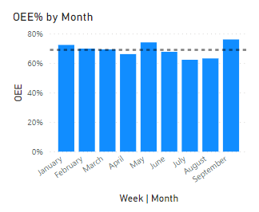
VISION SYSTEM
New Technology – Azure Stack HCI.
Status: Commissioned
Working with UniOps to deploy VM’s
70%
Mid-year of 2022 line was running at 52-56% due to an increase in pester losses

Slide 8

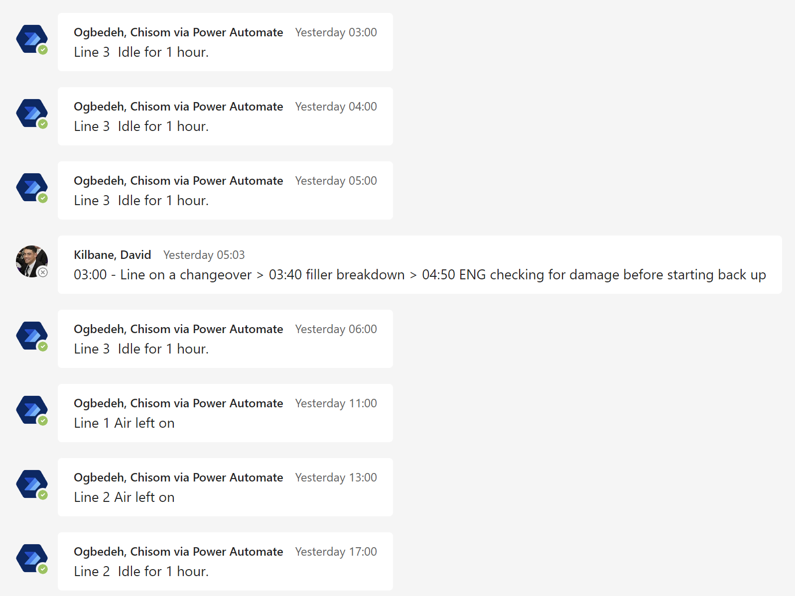
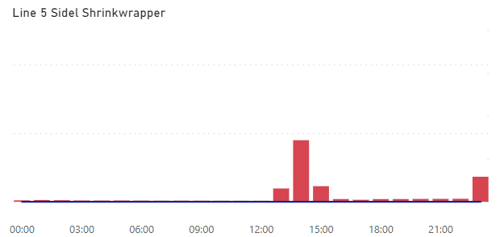
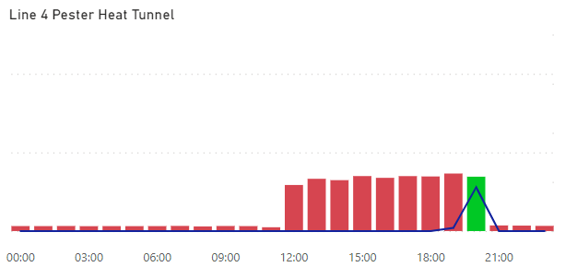




EOL counters on Packing Lines combined with Energy data from IoT sensors is used to identify when machines are running with no production hence idle. PowerAutomate used to trigger Notification when idle time longer than 1 hour detected
NOTIFICATION SENT AFTER WORK DONE. SHRINK WRAPPER TURNED OFF
SMART ENERGY
NO NOTIFICATION SENT. MACHINE LEFT ON UNTIL OP NOTICED
Notifications sent on Teams. FLL’s can comment the reason for idle time or turn electricity + air off if no production.
19
Specific Energy
(kWh/1000)
8.2%
17

Slide 9
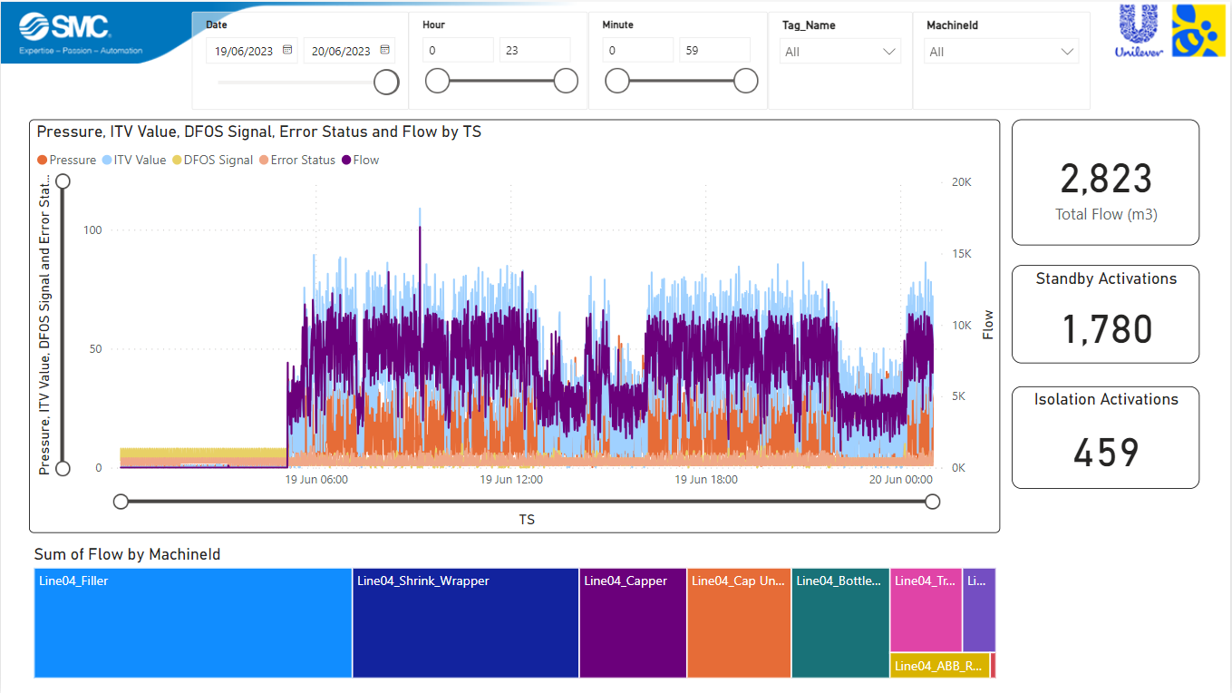

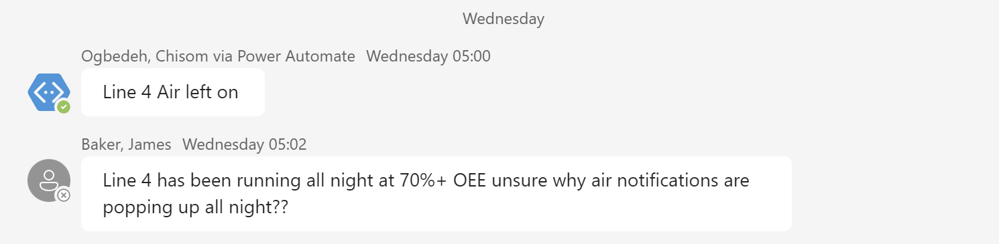
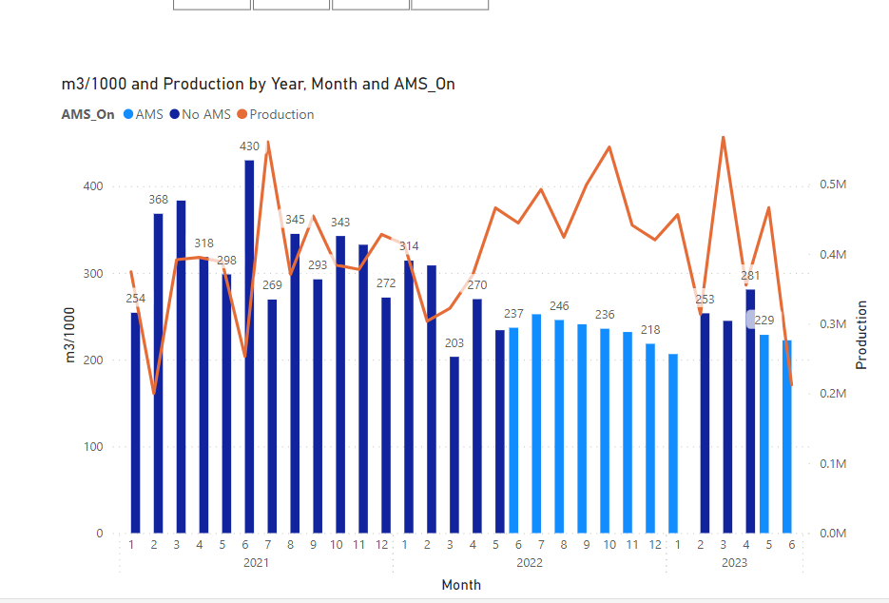

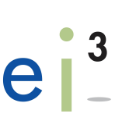
AIR MANAGEMENT
300
Specific Air
(m³/1000)
20%
230

Slide 10
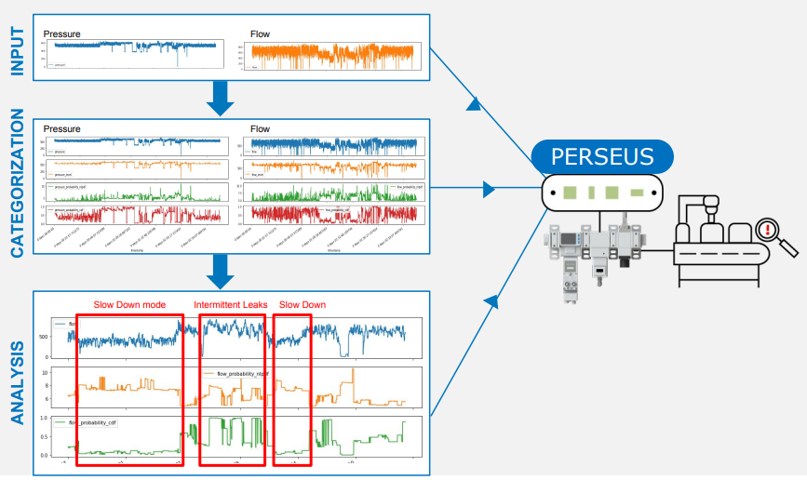
AIR MANAGEMENT
Advancing Pneumatic Control with AI
Leak Detection
Machine Fingerprinting for Condition Based Monitoring
Predicting Minor Stops

Slide 11
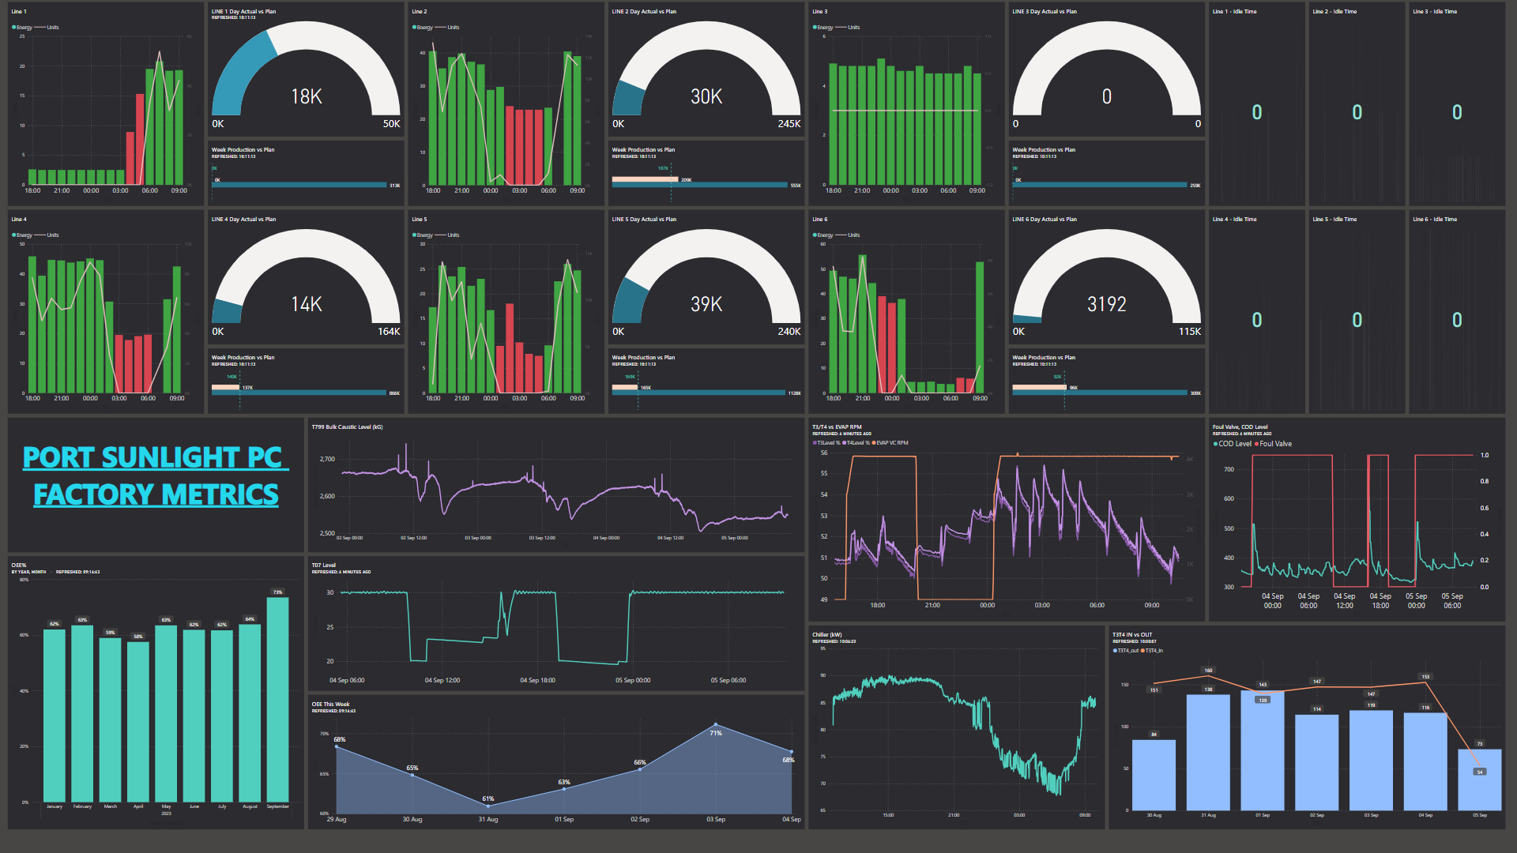
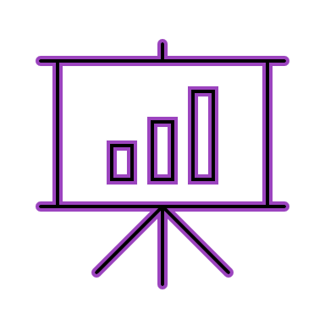
MONITORING KEY METRICS

Slide 12
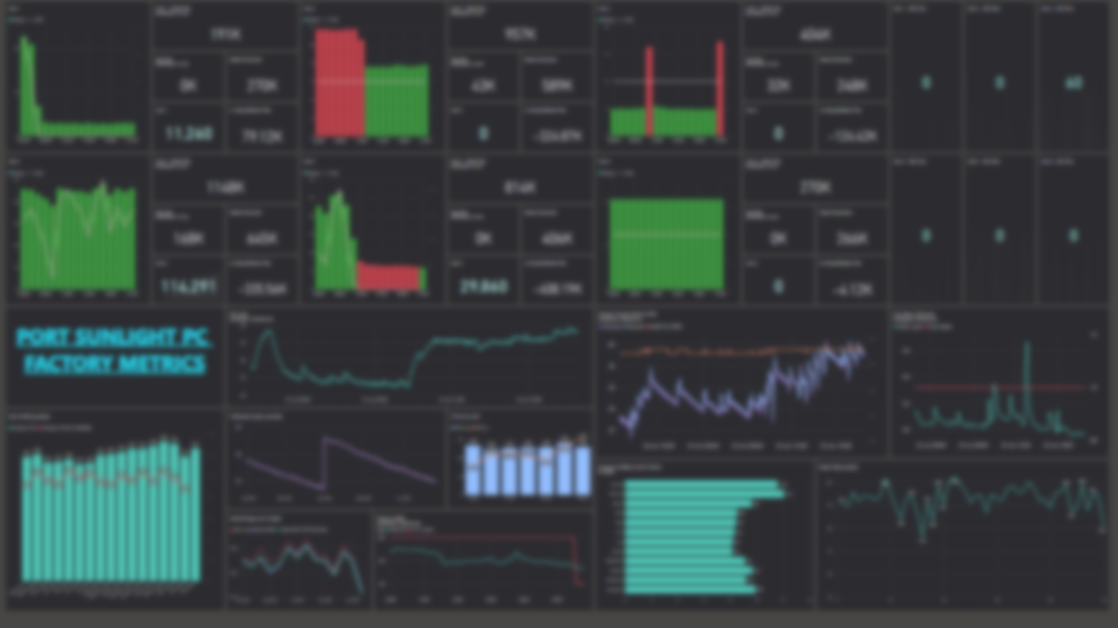
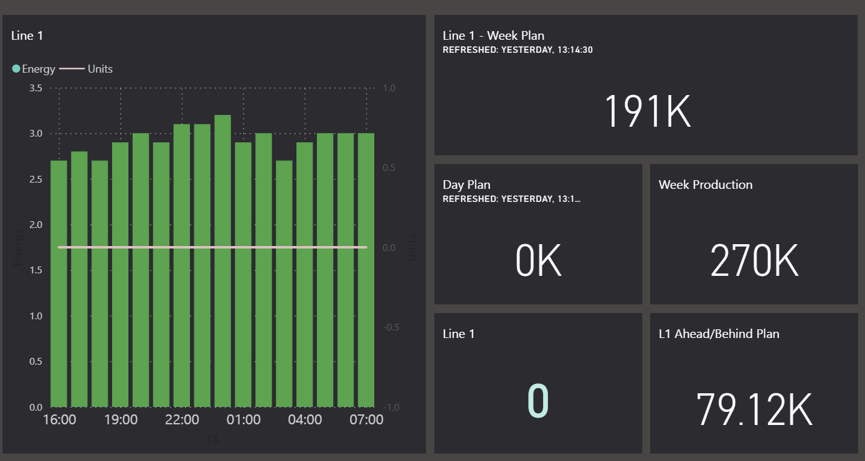
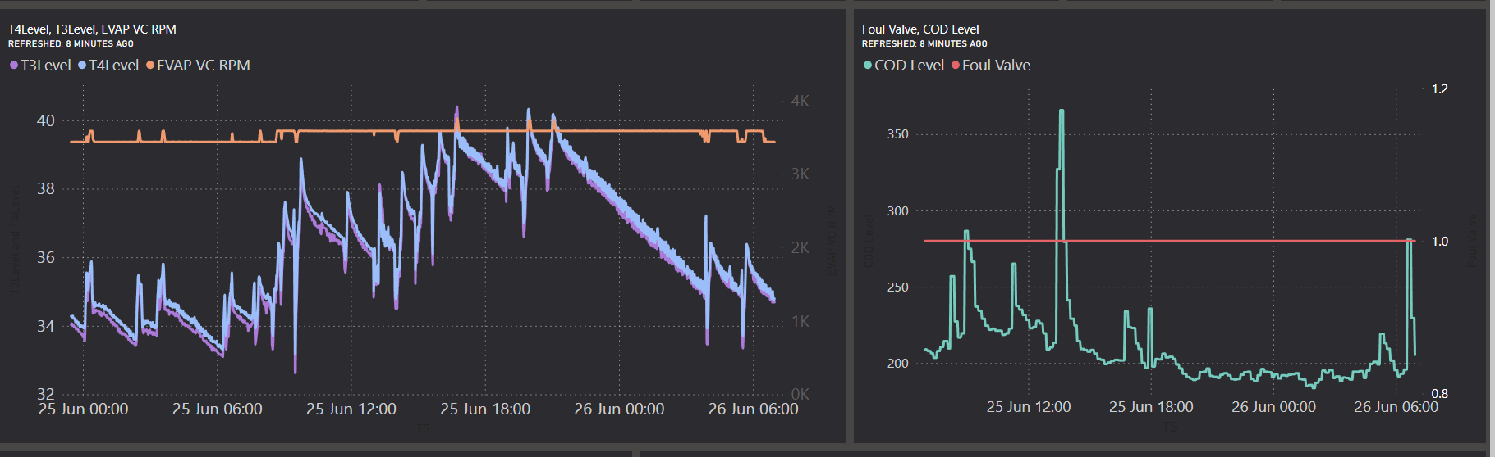

Slide 13
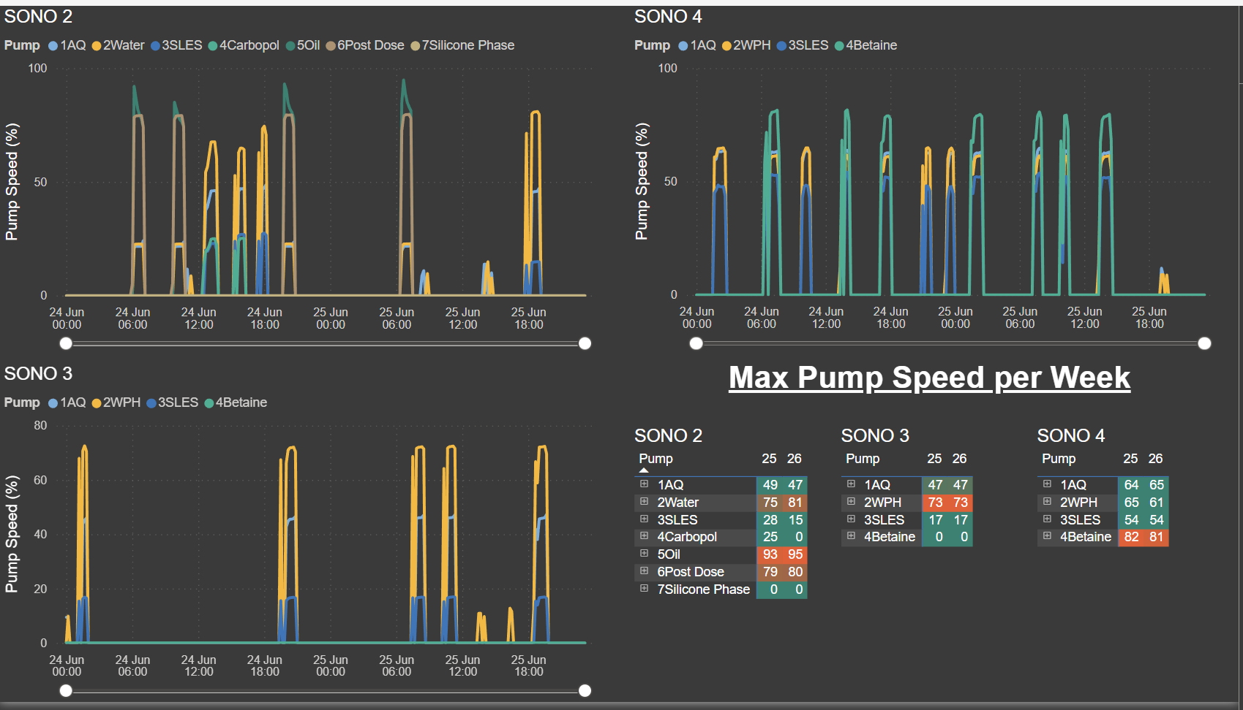

Slide 14
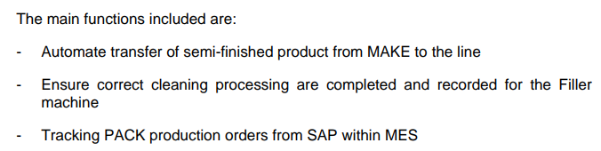
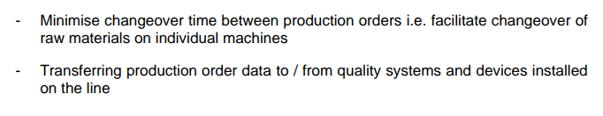
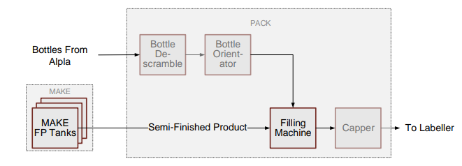

ONE TOUCH QUALITY
Synchronise MAKE & PACK
Reduce defects, improve Quality checking & Traceability
Remove NVAA

Slide 15
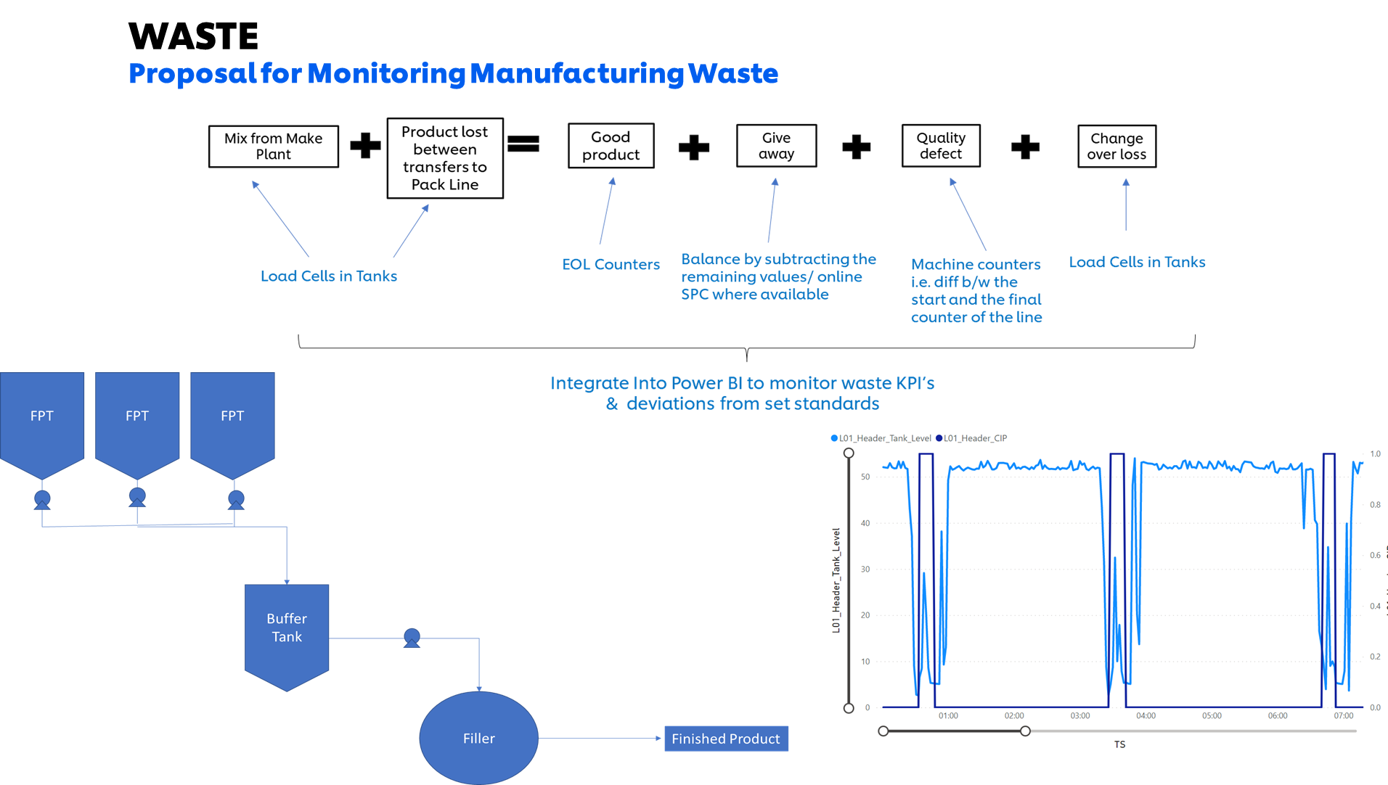
ONE TOUCH QUALITY

Slide 16
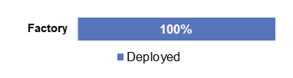
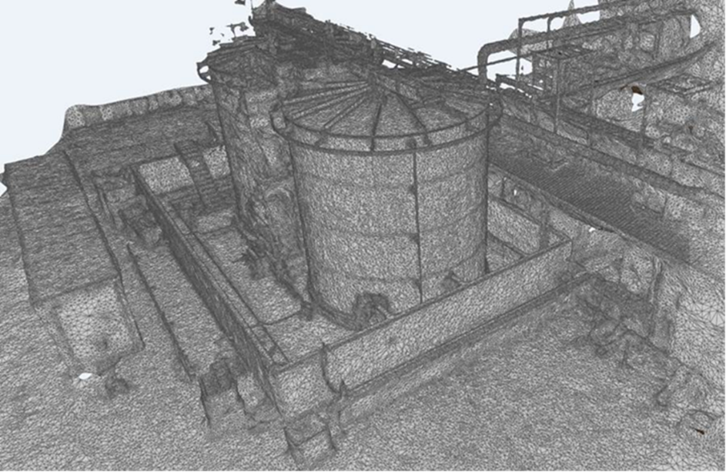
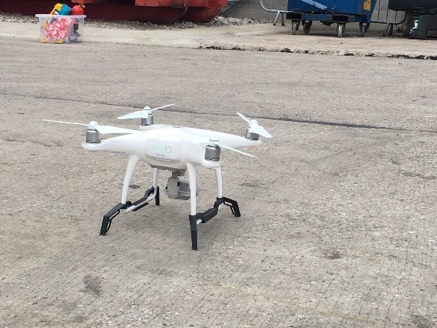
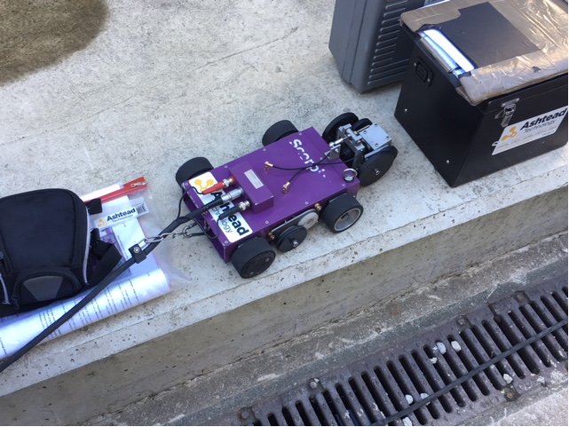
DRONE & SCORPION BUG FOR ULTRASONIC NON-DESTRUCTIVE TESTING
1
Description of use case
Technologies
Impact
Due to increase in production volume and changeovers from DBNR, a greater effluent throughput through the Waste Treatment Plant was required. It was necessary to conduct a thorough inspection of the Effluent Treatment tanks (T3/T4) to evidence structural integrity.
There were two different areas that needed to be covered;
The documentation and confirmation of size and volume of tank along with the measurements and positions of overflows and infeed pipework.
Testing the integrity and condition of the tanks as part of maintenance to ensure that they are still fit for purpose and in a condition suitable for continued utilisation.
The initial scope was for both tanks to be scaffolded to gain access to all areas. The cost of this was a huge barrier thus a digital solution was sought out to reduce this cost.
Using a Drone and Scorpion Bug, Ultrasonic non-destructive comprehensive testing could be carried out. This produced drawings ensuring all ports and pipework were captured, allowing accurate measurements of the tank volume and position of overflows.
These results provided confidence that the tank had minimal wear (all readings were around 7.8 – 8mm from an original depth of 8mm). It also provided confirmation of no pin holes that may have been present in the tank or the welds.
Drones & Ultrasonic Testing
Computer Aided Design
Point Cloud Modelling
Safety benefit - Eliminating working at height
£25k Scaffolding cost saving and 1 Week scaffolding time saving
100T capacity improvement providing volume to stop weekend tankers, saving £130k p/a
Enablers
Spread
Maintenance team and technicians fully involved to learn and develop new skills.
Factory covered
Problems addressed
Working at height
Effluent treatment capacity
Maintenance & Testing time
Design documentation

Slide 17

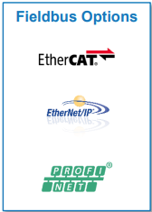
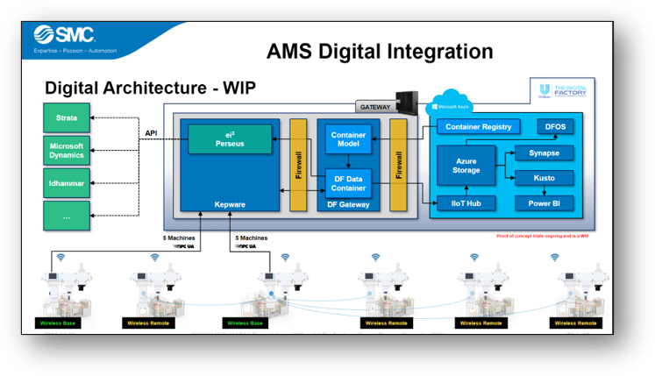
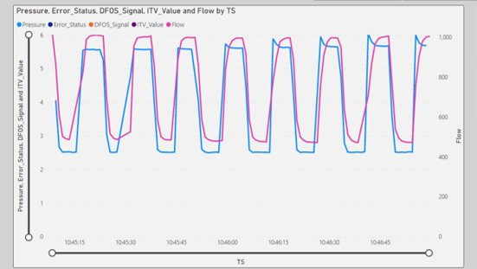

AIR MANAGEMENT SYSTEM (AMS)
2
Description of use case
Technologies
Impact
Business made clear that energy reduction and savings was a priority for the PC Factory at Port Sunlight
AMS was proposed to:
Reduce compressed air consumption through automatically regulating and isolating the compressed air that is provided to a machine
Reduce the carbon dioxide emissions related with reduced compressor loads
Utilise pressure, flow and temperature high level data to establish baseline conditions for machines. This allows preventative action to be taken to increase predictive maintenance.
Machine trials were carried out using two different types of AMS units (Manual and Electropneumatic). These trails gave a basis for savings and air reduction potential.
Built in OPC UA server
Wireless connectivity
High resolution 10Hz data
Webserver control
IO-Link connectivity
Supports major fieldbus protocols
30% Reduction in Specific Air translating to a £65k / year saving on Air
Annual carbon dioxide emission reduction of 38.18 tonnes, equating to a carbon credit cost saving of £3k
Increased predictive maintenance capabilities due to data baselines of pressure, flow and temperature
High resolution data capturing enables benchmarking of machines for comparison
Enablers
Spread
Multiple machine trials to show savings potential and emission reductions
Operator engagement and learning
Power BI data collection method
Communication between other potential Unilever users
External partner relationship
Port Sunlight PC Factory Line 4 – deployed
Port Sunlight PC Factory Line 2 – ongoing
Port Sunlight PC Factory remaining lines - planned
Problems addressed
Overconsumption of compressed air when not needed
Carbon dioxide emissions being too high
Lack of machine visibility, leading to poor predictive maintenance opportunities
No high resolution, continuous data for machines

Slide 18
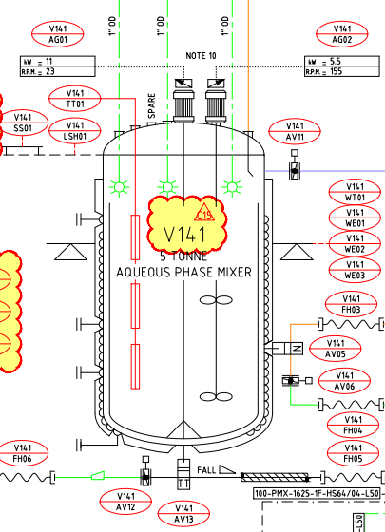
FLEXIBLE BATCH SIZE
3
Description of use case
Technologies
Impact
Back in 2021 the business made it very clear that our planning strategy had to change, to move closer to a make to order system, with the view to unlocking the stock savings.
This created a key challenge for PSL PC Factory in that the original business case for the factory was built on Sonolation 20T batch sizes and high frequency throughput, i.e., lots of 20T batches of the same product made in long production campaigns. Therefore, the factory is inherently designed for 20T batch sizes with all sonolation plant equipment sized to a 20T scale. The business now wants the total opposite, smaller batch sizes and fewer of them.
Therefore we created a software system which allows us to automatically scale down a batch size from 20T to as low as 5T scale.
This project also made improvements to our sonolation rework system. With CoNET we modified the PCS7 software to highlight the level of “GOOD” material produced during the sonolation start up process. We created visuals on screen to show the level of good and bad material which then help the operators to understand the rework rate. The new “good” product changes are, when a sample passes QC checks, the system converts the sample time product from bad to good.
Sonolation Process Technology
SAP (Enterprise Resource Planning – ERP – system)
MES (Felten - Manufacturing Execution System = raw material management)
PCS7 (CoNET – Batch Production Software System)
Enabled smaller batch sizes to be made to meet DBNR / lower MOQ demands (8T batch size validated)
EU DBNR cost savings = €10m+
The system more accurately calculates good and bad product from the start up process. Which allows the system to rework the start up material at a higher rate and therefore reducing overall batch waste.
Enablers
Spread
Synergy and connection between SAP, MES & PCS7 batch production software systems.
Make Plant trials / checks
Make Plant Operator engagement
A central DBNR Planning Matrix
Port Sunlight PC Factory covered
Problems addressed
Our Sonolation Process systems were originally designed to only make 20T batch sizes
Too much money tied up in stock in warehouse
Notes:
Reforçar como o projeto transformou nossa forma de trabalhar
Foco no real

Slide 19
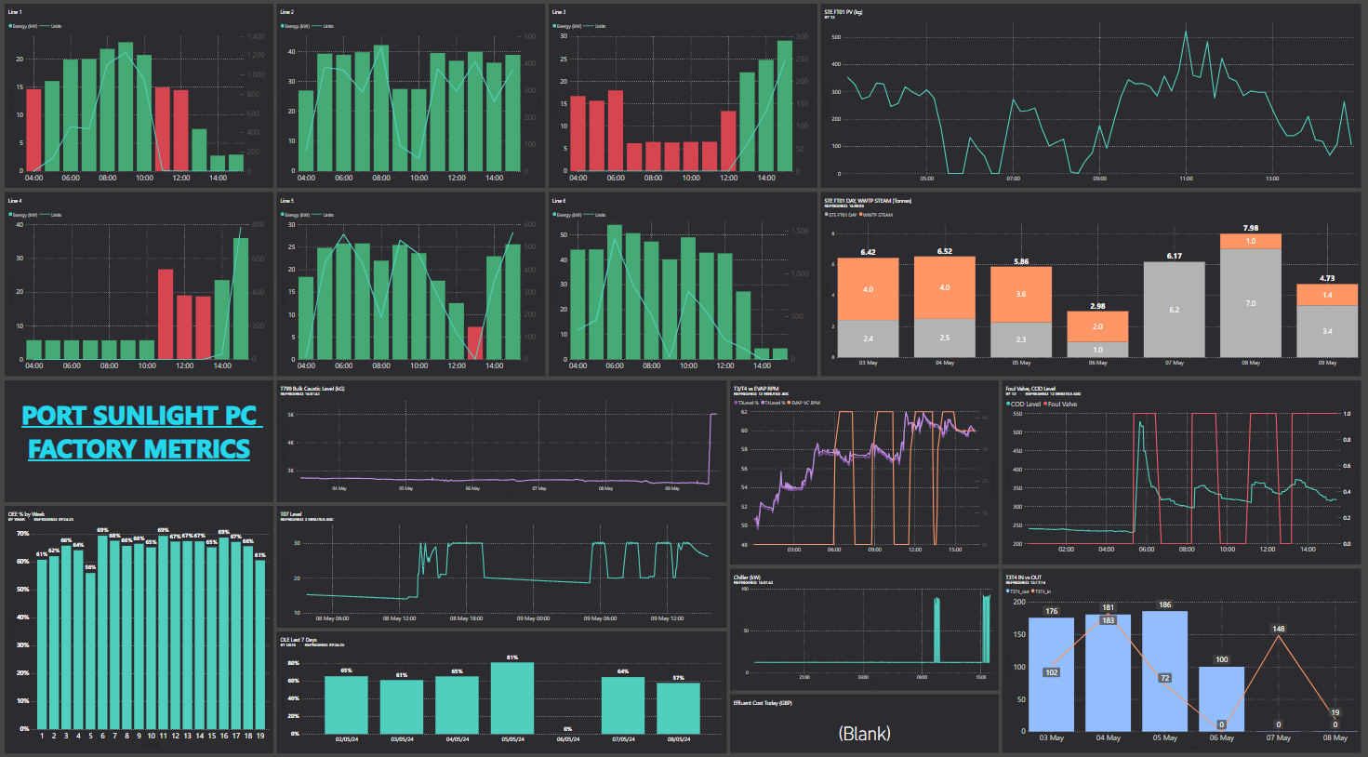



SMART ENERGY MANAGEMENT
4
Description of use case
Technologies
Impact
To deliver a reduction in energy consumption and align with sustainability goals, IoT sensors on machinery coupled with factory PLC data streaming into the Azure data lake was used to deploy an automated energy monitoring and management system.
An analytical layer built using Microsoft PowerBi and Power Automate is used to not only track idle consumption, but send notifications to cell teams when energy intensive machinery such as the Shrink Wrapper are left on with no production.
Additionally, data-driven decisions were used to identify and implement reductions in make baseload which constitutes 60% of the overall consumption.
Centrica Energy Monitoring IoT Sensors
PowerBi real time energy data visualisation
Digital Factory architecture to provide real time production data
Connection between Centrica Machine electricity data to factory production data
35% Reduction in kWh/1000 pcs (pack)
70% Reduction in HVAC baseload (make)
Enablers
Spread
Inclusion of energy monitoring & metrics in daily Run-to-Standard cell team meetings
Solid Digital Factory infrastructure
Operator involvement & increased awareness of energy consumption
Factory covered
Problems addressed
Energy over-consumption
Wasted energy due to Heat Tunnels not switched off post-production
High energy baseloads due to system inefficiencies
Notes:
Reforçar como o projeto transformou nossa forma de trabalhar
Foco no real

Slide 20
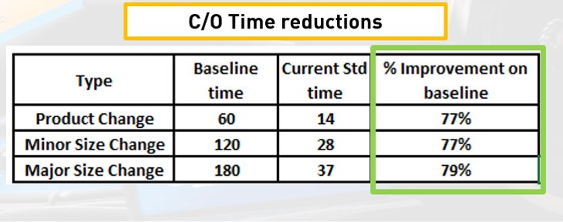
SMED+ Changeover Reduction Project
5
Description of use case
Technologies
Impact
Unilever are changing the planning strategy across the entire business. The Vision is ‘What we sold yesterday; we need to produce today’. This can be made achievable by making the supply chain more agile and flexible by optimising cost, cash, inventory, and service.
To achieve the goal, We must reduce the batch sizes and increase the number and frequency of changeovers at packing line level. This is being quantified is by setting a target of ‘days between next run’ (DBNR). The smaller the DBNR number is, the more efficient and streamlined the strategy needs to be, however, production line efficiency cannot be negatively affected, or the strategy project will fail
The goal of the project is to reduce the time in which it takes the production line to complete size changeovers, by over 50%. The long-term goal is to achieve single minute changeover time (9) for physical changing/adjusting of machine parts.
This will reduce the downtime required for changeovers. Therefore, offset the increase in number of changeovers through a reduction of the DBNR number, whilst maintaining overall line efficiency (OLE). The DBNR target is 7 days for all ‘A class SKUs by the end of 2022
The areas of focus are
Implement McLaren Changeover app on all lines
Digitalised Automatic Guide Rail adjustments & 3D printed gearboxes (L6)
Delivery of a full line with multi position parts (L6)
Utilise 3D scanning, Design and Printing of machine parts
3D Scanning / cloning of existing machines,
3D design of new parts
3D printing of machine change parts
Digital changeover app
Automated single touch guide rail changeover
Enablers
Spread
Operator engagement
External supplier support
3D printing expertise / resource
Line trials and time study
Capex
Changeover app deployed globally
SMED+ methodology and 3D scanning / printing approach scaled globally
Problems addressed
Changeover time / loss
Reduction of stock in warehouse and costs
Increased Agility
Notes:
Reforçar como o projeto transformou nossa forma de trabalhar
Foco no real

Slide 21
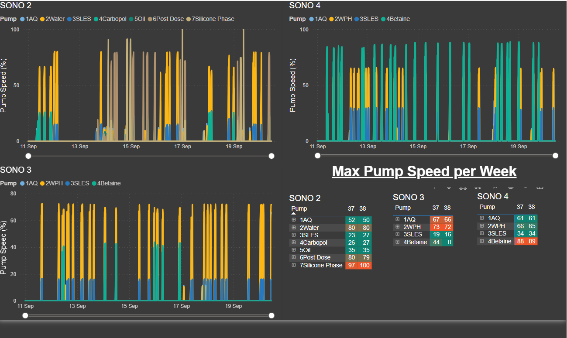
DIGITAL MAINTENANCE MANAGEMENT
6
Description of use case
Technologies
Impact
Manufacturing Engineers in the make plant carry out weekly checks on production critical pumps. The max pump speed is checked during a run and this correlates to the health of the pump. This data is pulled from the PCS7 database and streamed into the cloud and displayed on a dashboard that can be accessed by all engineers. Weekly, a snapshot is taken with the pump
Speeds compared
To the previous
week
Microsoft PowerBI
OPC UA Server
Azure datalake
Azure Data Explorer (Kusto)
2 hours saved every week from engineer not having to do manual checks every week.
£ xxx cost avoided due to planned pump change (tbd)
Enablers
Spread
DF infrastructure
Factory covered
Problems addressed
Auto monitoring 15 Sono pump speed
Notes:
Reforçar como o projeto transformou nossa forma de trabalhar
Foco no real

Slide 22
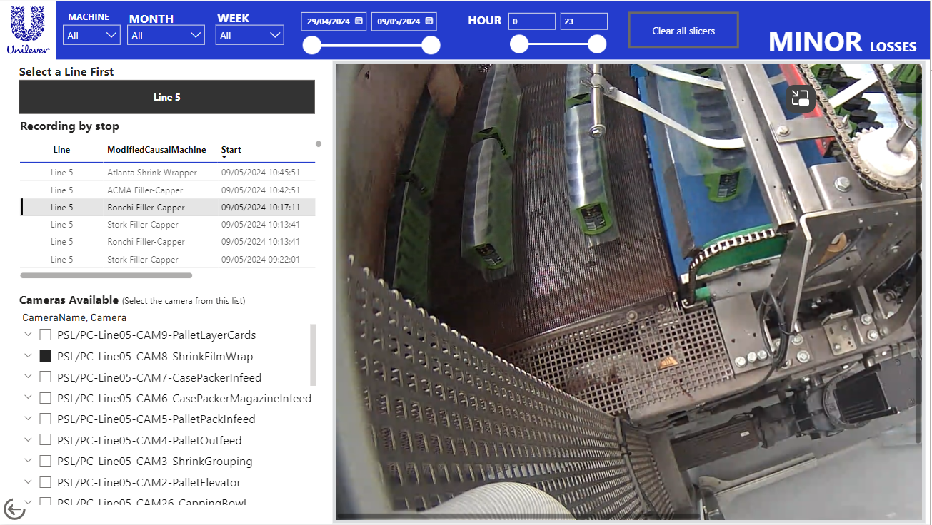
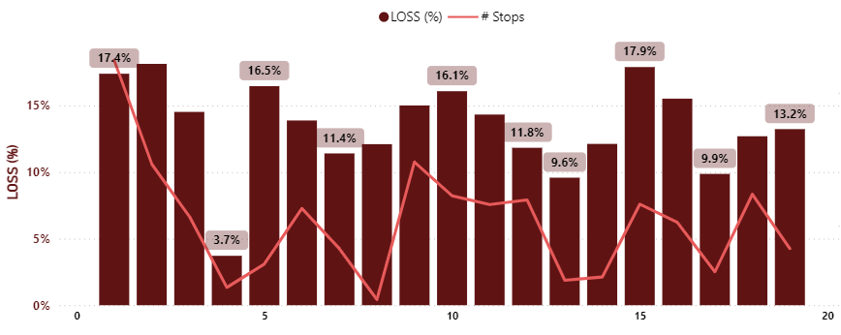
MINOR STOP VISION SYSTEM
7
Description of use case
Technologies
Impact
Minor stop reduction​
Minor stops makes up for most of the downtime experienced in B&PC – 20% OLE loss.​
The aim is to halve the deficit and recover 10% of losses by Q2 2023.​
​
Installation of the first HCI stack server within Unilever brings cloud computing power to the edge. ​
The system incorporates 108 cameras installed across all the machines to enable minor stop capture & analysis in conjunction with DFOS.
IoT sensors
Data visualisation using PowerBi
Hanwar CCTV Cameras
Azure Cloud
MSFT Stack HCI
Minor stops decreased by 25%
OLE Increased 6%
Enablers
Spread
DFOS
Factory covered
Problems addressed
Minor Stops
Notes:
Reforçar como o projeto transformou nossa forma de trabalhar
Foco no real

Slide 23
PREDICTING VISCOSITY
8
Description of use case
Technologies
Impact
PSL PC uses a Sonolation process to manufacture products. The system pressure and temperature have been identified as parameters critical to the quality of the end product.
Based on pressure and temperature sensor data streamed to the cloud, linear regression pressure drop models will provide a “real time” viscosity prediction which will be sent to PCS7 at the “take sample window” stage​.
If prediction is in spec, Sono will not stop for QC, product will be sent to the FPT saving QC time and eliminating start up material requiring rework
Azure Machine Learning
PCS7 (CoNET – Batch Production Software System)
Start up tank Waste reduction - £50k
30 mins BCT saving per RFT batch. Based on 3000 batches per year, this is a saving of 1125 make plant hours at 75% RFT or 1500 hrs at 100% RFT.
Enablers
Solid Digital Factory infrastructure
Make Plant trials / checks
Spread
Sono 1 – 4
Problems addressed
Quality checking
Waste due to out-of-spec product

Slide 24



Monitoring
Analytics
Insight
One Touch Quality
Port Sunlight PC aims to join the Lighthouse Network

